Slide 1
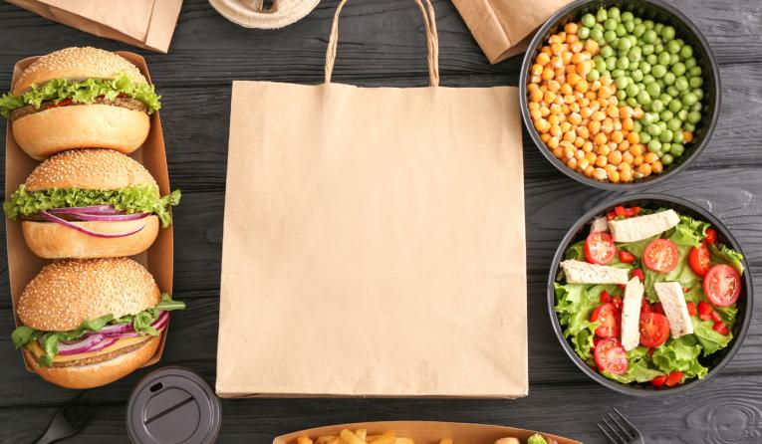
CSYE7280
User Experience Design & Testing
Under Guidance of: Prof Vishal Chawla
ASSIGNMENT – 06
Research Study
‘Bon Appette’ – A Food Delivery App
Team Members – Group 05
Nikita Gaurihar - 002980962
Meenakshi Kumbhar - 002922024
Nikhitha Dasi Srinivas - 002922544
Ikra Bagwan - 002794307

Slide 2
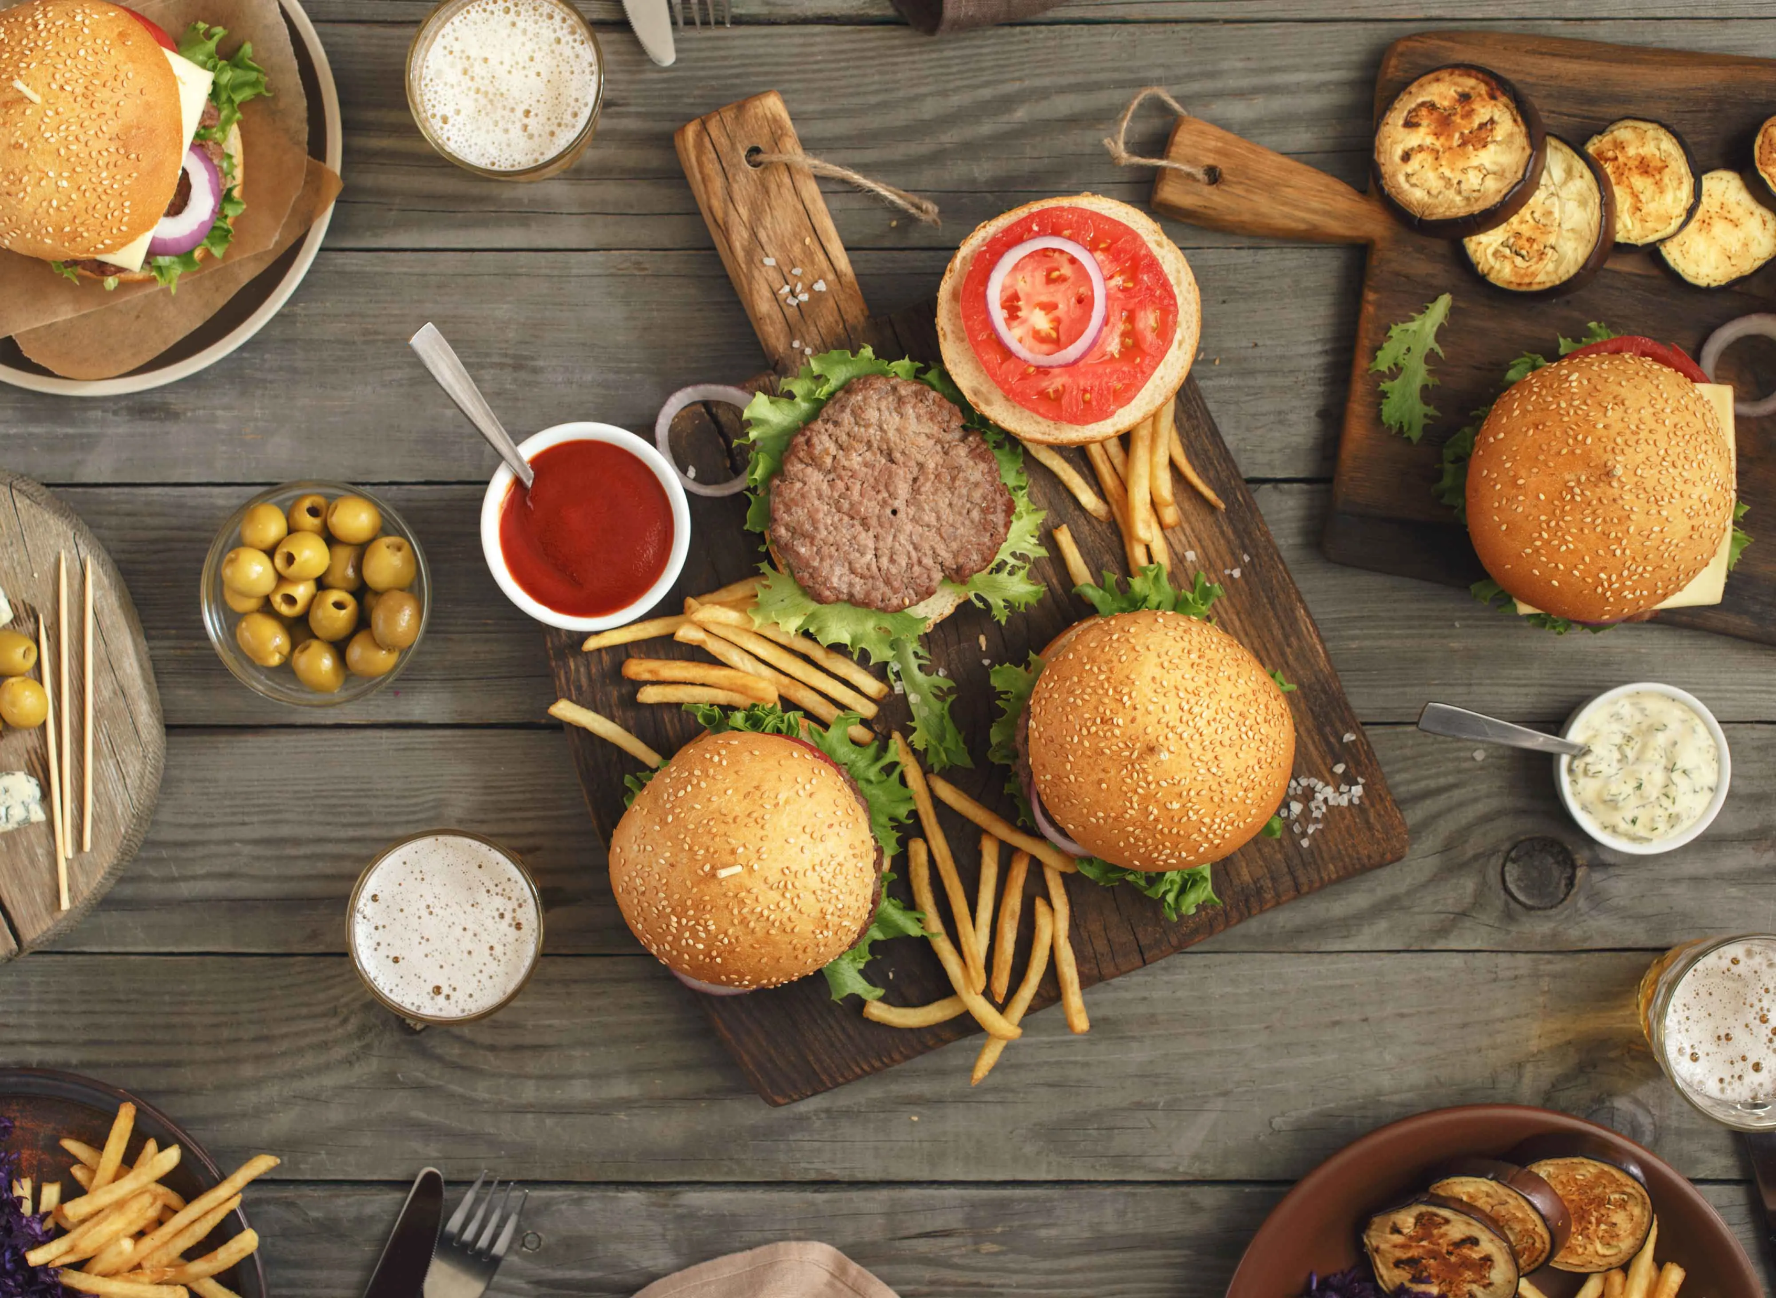
Contents
Objective of the Research
Field Study
Surveys
Search-Log Analysis
References

Slide 3
Objectives
To collect the reliable data and understand our target audience’s needs.
To help us gather data to improve User-experience of the Food-delivery apps by analyzing the gaps.
To implement the research methodologies –
Field Study
Survey
Search-Log Analysis

Slide 4

Field Study
Field study offers a comprehensive perspective of how your customers behave in the "real world” to a particular product or system.
By observing people’s natural behavior in their natural habitat, we can answer the following:
What type of environment will they be using the product in?
How do they perform tasks?
What tools do they currently use to accomplish their goals?

Slide 5
Step 1
Identify and acquire researchers in the field
Step 2
Identify the research objectives
Step 3
Identify the right method of research
Ethnographic Field Notes
Qualitative Interviews
Direct Observation
Participant Observation
Step 4
Visit the site of the study and collect data
Step 5
Analyze the data acquired
Field Study Methodology

Slide 6
Identify
Identify users' needs
Gain
Gain insights into user behavior
Identify
Identify usability issues
Generate
Generate new design ideas
Obtain
Obtain data for journey maps, personas, use cases, and user stories
Test
Test systems under realistic conditions.
Understand
Understand Cultural context
Field Study – Needs & Benefits

Slide 7
Field Study - Implementation
Ethnographic field notes and Qualitative interviews implementation methods-
1. Conduct qualitative interviews with the participants to understand their food ordering behavior, challenges, and expectations.
2. Conduct ethnographic field notes by observing the participants ordering food, interacting with the app, and using the features.
3. Conduct user interviews and testing to create a feedback and ratings platform that is easy to use and provides useful information to users.
4. Analyzing the data gathered from the interviews and ethnographic field notes to bridge the gap in the existing application to make seamless user experience.
5. Identifying pain points in the ordering process and where the product's user needs can be better met.

Slide 8

Survey
Survey is collection of quantitative and qualitative data about a user's interactions and experience with a website or digital product.
Importance:
Customer satisfaction
Improved Business Decisions
Increased Revenue
Continuous imnprovements
Efficient Operations

Slide 9
Survey - Methodology
Identify target audience
To determine survey method
Designing survey questions
Conducting survey
Analyze data

Slide 10
Survey – Needs & Benefits
Needs
Benefits
Helps in collecting data across the globe
Can collect data about the behaviors, needs and opinions
Helps in gauging the client satisfaction, opinions of various issues, finding out the overall reaction
Easy to Administer
Cost –effective
Helps in collecting quantitative and qualitative data
Capable of collecting data from numerous respondents
Conducted on-line as well as in-person
Reduces Geographical dependence
Developed in less time

Slide 11
Survey - Implementation
Online Survey
In-Person Survey
Phone Survey

Slide 12
Larger Target
Quick responses
Higher response rates
Visual aids
Less expensive
Time- efficient
Quick data compilation
Why Online Survey – Questionnaire ??

Slide 13
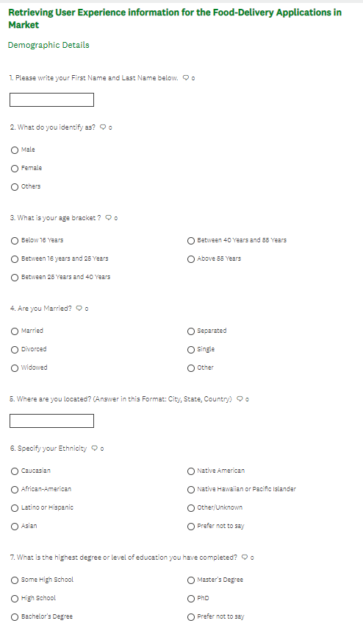
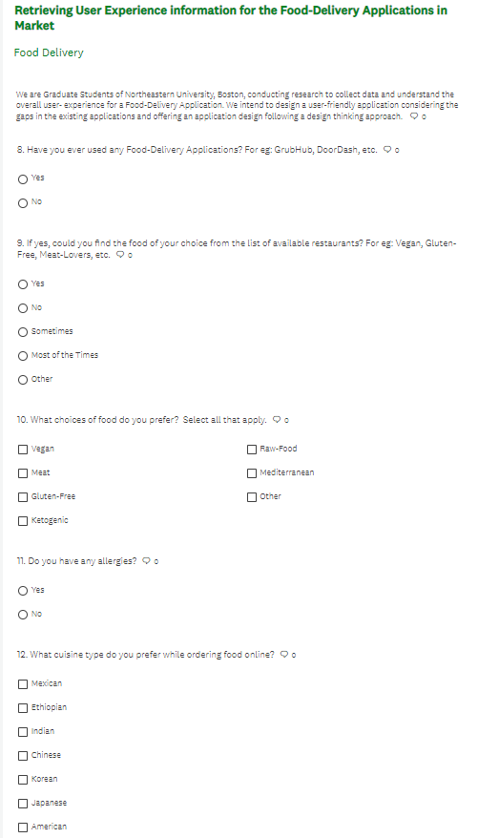
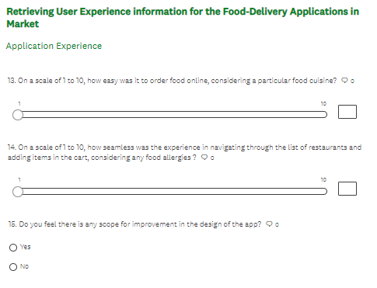
Implementation: Questionnaire

Slide 14
Search-Log Analysis
Search Log is a file that consists of the user’s interaction data questions with the website.
Search log Analysis uses the data collected in the search log to understand the research queries among the users, web search engines, or web content during the searching episode.
Helps to achieve stated objectives, such as improved system design, advanced searching assistance, or better understanding of some user information searching behavior.
Methodology
SLA involves three stages:
Importance
Helps to understand the below questions easily:
What people want but can't find
What people want but does not exist
The difference between users' vocabulary and the website's vocabulary
Terms people misspell frequently and others with very poor results
Stage 1: Data collection
Stage 2: Preparation.
Stage 3: Analysis

Slide 15
Search-Log Analysis – Needs & Benefits
Needs:
It benefits the stakeholders to empathize with site visitors because the data shows people struggling to find what they need.
This information can help gain support for improving the website because it usually illuminates problems that are frequently encountered and difficult to fix without doing significant work.
Benefits:
Improve application design issues
Enhancing content strategy
Understanding the user’s needs
Search functionality

Slide 16
Search-Log Analysis - Methodology
Most searched keywords for the food delivery application are biryani, fries, and pasta
Mexican is the most preferred cuisine among adults
To determine the popular meal among the restaurants
Usage of fast food delivery is more when compared to healthy items
Identified the peak hours for the orders

Slide 17
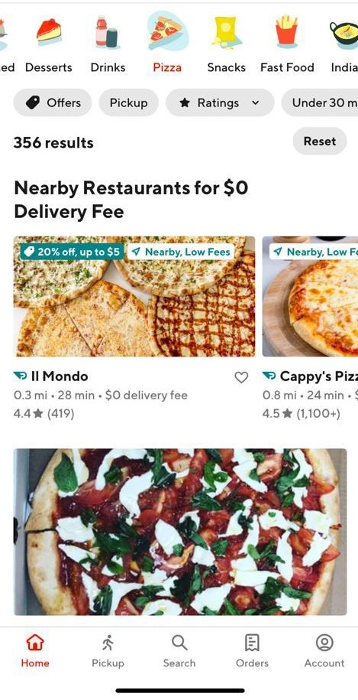
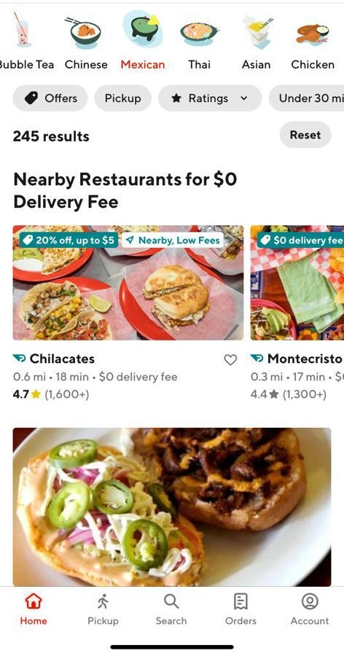
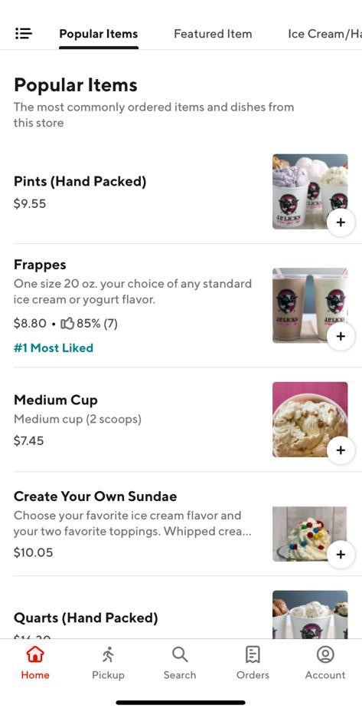
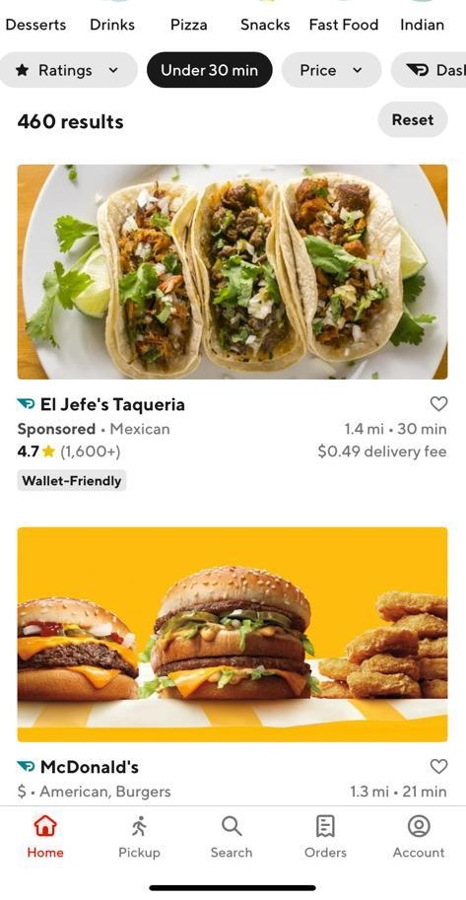
Search-Log Analysis - Implementation

Slide 18
References
https://www.netizenexperience.com/blog/usability-testing-vs-field-studies/
https://www.enago.com/academy/how-conduct-field-research-study-complete-guide/
https://www.nngroup.com/articles/field-studies/#:~:text=Definition%3A%20Field%20studies%20are%20research,doesn't)%20with%20participants.
https://www.questionpro.com/blog/field-research/
https://www.surveymonkey.com/create/
https://www.snapsurveys.com/blog/advantages-disadvantages-surveys/
https://www.nngroup.com/articles/open-ended-questions/
https://www.nngroup.com/articles/search-log- analysis/
https://faculty.ist.psu.edu/jjansen/academic/jansen_search_log_analysis.pdf
https://www.projectpro.io/article/how-food-delivery-apps-are-leveraging-big-data-analytics/197

Slide 19
Thank You

